Slide 1
Week 7 Update
26 February 2021

Slide 2
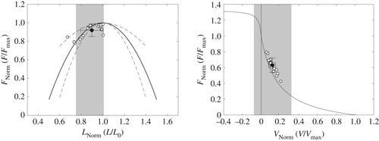
Biomechanical Analysis
Valuable insights can be gained from analysis of biomechanical quantities that are used to calculate muscle forces, ^{[20]} and thus metabolic energy expenditure, ^{[24]} during movement
Studies have been performed to show that muscles’ shortening velocity, force-length curve, and force-velocity curves have “important implications for...muscle efficiency” ^{[22] [23]}
We can use biomechanical quantities as a secondary measure to analyze how metabolic energy expenditure changes as a function of seat position
Shaded regions indicate ranges of maximum force generation on the force-length curve (top) and force-velocity curve (bottom)
(Adapted from Bohm (2019) [22])

Slide 3
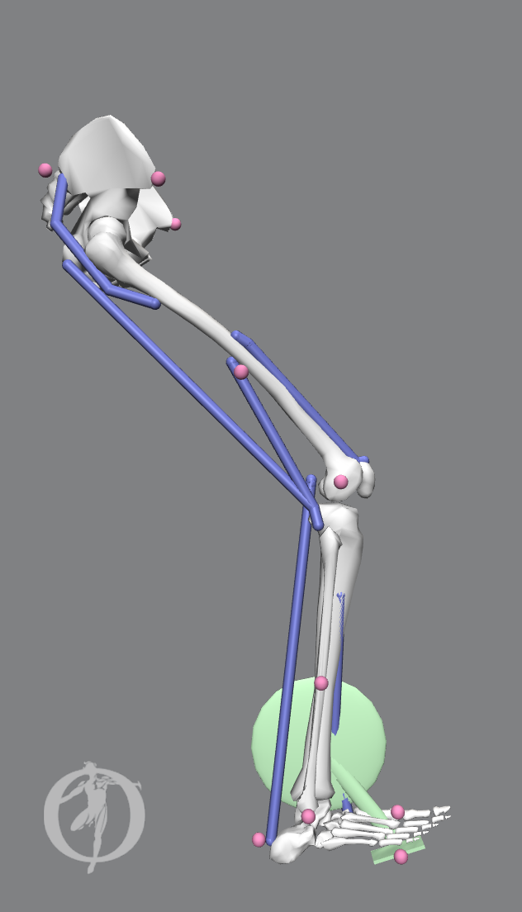
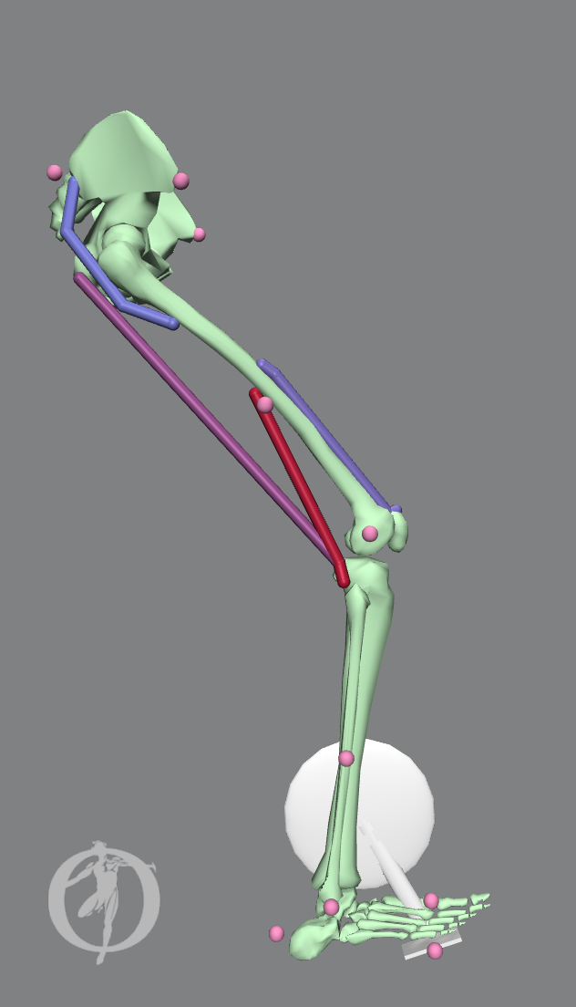
Workflow
(Passive) Simulated Forward Kinematics
(Active) Computed Muscle Control
Parameterized input: Saddle Position
Muscle Activations: [A₁ , A₂ , … A_{n}]
Muscle Forces: [M₁ , M₂ , … M_{n}]
Metabolic Energy Expenditure Rate:
[P₁ , P₂ , … P_{n}]
Trial 1 (x₁ , y₁)
Trial 2 (x₂ , y₂)
...
Joint Angles: [Q₁ , Q₂ , … Q_{n}]
Muscle Lengths: [L₁ , L₂ , … L_{n}]
Muscle Velocities: [V₁ , V₂ , … V_{n}]
External Forces: [F₁ , F₂ , … F_{n}]
Trial n (x_{n} , y_{n})
+
Model constraints on coordinates
q_{i} ↔ q_{j} , i ≠ j
n = trial number
= driving the motion
Notes:
Parameters: GRFs, saddle height/position, kinematics, cadence,
The first step will always be making any necessary adjustments we need to make to the OpenSim model for the next iteration. It’s at this point where we choose a new saddle position for a example.
Then we generate a new set of joint angle trajectories and external force profiles using the adjusted model for our CMC Tool.
We then need to tailor the OpenSim specific files and scripts that the CMC Tool requires. The content of these files are directly influenced by every aspect of the OpenSim model, and so they must be updated for every physical change made to the model.
With all of the files needed for the CMC Tool organized, we can finally simulate a pedaling motion for the model and extract outputs of interest such as muscle excitation profiles and metabolic energy consumption probes.
Lastly, before beginning a new iteration cycle, it is important to compare the simulation outputs to our previous iterations to judge what qualitative improvements are being made.

Slide 4
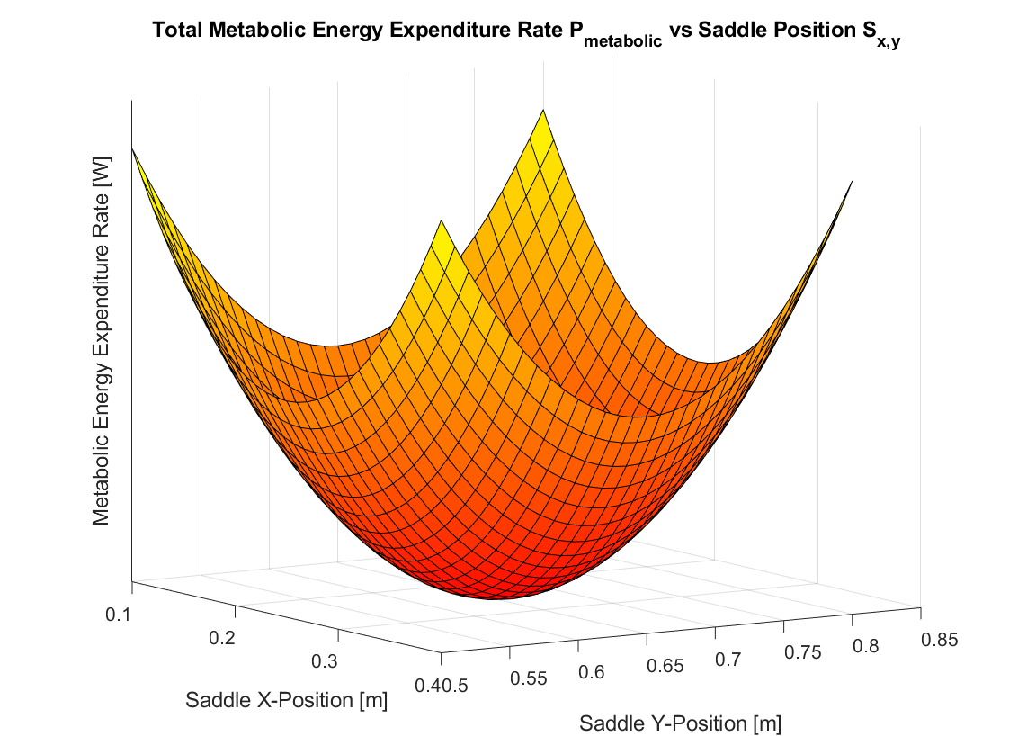
Compile Results
Idealized plot of metabolic energy expenditure vs. saddle position
Muscles Activation: [A₁ … A_{n}]
Muscles Forces: [M₁ … M_{n}]
Metabolic Energy Expenditure Rate:
[P₁ … P_{n}]
Notes:
Each muscle, given it’s force length and force velocity relationship can output a potential maximal force (given fiber length, fiber velocity) over time of a crank rotation
CEC
With our simple model, we were able to complete the final step in our workflow to show a successful CMC run.
All 4 muscles are activated in the pedaling motion.
The overall kinematics of the hip, knee, and ankle joints are acceptable
Achieved constant cadence model
we have since achieved similarly successful results with other models.

Slide 5


How things are going: Debugging

Slide 6
How things are going: Debugging

Slide 7
Timeline
→ Currently in progress
Week 2 | Week 3 | Week 4 | Week 5 | Week 6 * | Week 7 | Week 8* | Week 9 | Week 10
1/22 | 1/29 | 2/5 | 2/12 | 2/19 | 2/26 | 3/5 | 3/12 | 3/19
OpenSim learning |  |  | Define workflow | Parameterize saddle height
Literature research |  |  |  | Develop higher complexity models (2-leg, additional muscles)
Workflow development |  |  | Ensure GRF at pedals is reasonable |  |  | Collect data on parameterizations
Meet with OpenSim experts & document research and process thoroughly
 | Compute muscle forces & metabolic output through CMC
*Presentation on Monday
Notes:
[cc] This timeline has a visual representation of our work for the next several weeks. The blocks in green are currently being worked on and we have a couple weeks at the end for buffer and final wrap up activities.

Slide 8


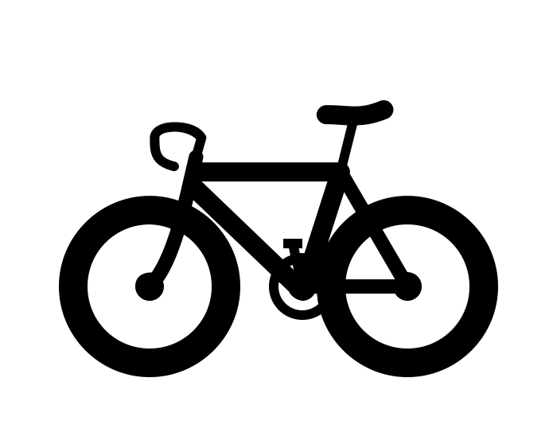

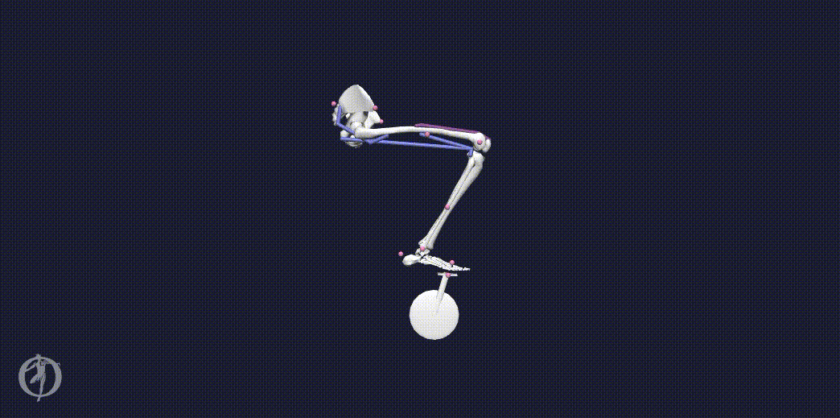
Thank you
INSERT BLOOPER GIFS
Notes:
1’ - all

Slide 9
Notes
Justin: Can we get torsional stiffness of the joints?
Apparently stiffness depends on muscle activation
Looking at the extremes of joints? Would be useful
LOOK IN OSIM, ASK CARMICHAEL
Notes:
1’ - all

Slide 10
References
Kipp, Shaylaya, et al. Extrapolating Metabolic Savings in Running: Implications for Performance Predictions. Frontiers in Physiology, (2019).
Faulkner, S. and Jobling, P. The Effect of Upper-Body Positioning on the Aerodynamic-Physiological Economy of Time-Trial Cycling. International Journal of Sports Physiology and Performance, (2020).
Uchida TK, Seth A, Pouya S, Dembia CL, Hicks JL, Delp SL (2016) Simulating Ideal Assistive Devices to Reduce the Metabolic Cost of Running. PLoS ONE 11
Bini RR, Tamborindeguy AC, Mota CB. Effects of saddle height, pedaling cadence, and workload on joint kinetics and kinematics during cycling. J Sport Rehabil. 2010
Henrot, C and Jeffries, L. OpenSim Teaching Materials -- Educational Cycling Model. BIOE-ME 485 Spring 2018
Dodge, David. The Most Efficient Transportation On the Planet. Huffington Post Online (2013).
Koelewign, A. D. et al. Metabolic cost calculations of gait using musculoskeletal energy models, a comparison study. PLOS ONE 14(9): e0222037, (2019).
Dembia CL, Silder A, Uchida TK, Hicks JL, Delp SL Simulating ideal assistive devices to reduce the metabolic cost of walking with heavy loads. PLOS ONE 12(7): e0180320, (2017).
Jackson, R. W. and Collins, S. H. An experimental comparison of the relative benefits of work and torque assistance in ankle exoskeletons. J Appl Physiol 119: 541–557, (2015).
Leib, D. The Effects of Clear Placement on Muscle Mechanics and Metabolic Efficiency in Prolonged Sub-Maximal Cycling. Ball State University Biomechanics Laboratory Thesis, (2008).
Pottinger, M. Inverse Dynamic Analysis of ACL Reconstructed Knee Joint Biomechanics During Gait and Cycling Using OpenSim. California Polytechnic State University, San Luis Obispo Thesis, (2018).
Coleman DA, Wiles JD, Davison RC, Smith MF, Swaine IL. Power output measurement during treadmill cycling. Int J Sports Med. ;28(6):525-30, (2007).
Peveler, W. and Green, J. Effects Of Saddle Height On Economy And Anaerobic Power In Well-trained Cyclists. National Strength and Conditioning Association , Vol 25, 3, (2011).
Hull, M.L. and Jorge, M. A Method For Biomechanical Analysis of Bicycle Pedalling. Journal of Biomechanics Vol 18 No 9. pp 631-644, (1985).
Gonzalez, H. and Hull, M.L. Multivariable Optimization of Cycling Biomechanics. Journal of Biomechanics Vol. 22 No 11/12 pp 1151-1161, (1989).
“hip angle” Ducking Tiger. Web. Accessed 4 February 2021. <https://www.duckingtiger.com/can-we-use-road-bike-instead-of-tri-bike/hip-angle/>
“Getting Started with CMC” OpenSim Documentation. Web. Accessed 24 January 2021. <https://simtk-confluence.stanford.edu/display/OpenSim/Getting+Started+with+CMC>
Tucker, J. Personal E-mail Correspondence. 13 January 2020.

Slide 11
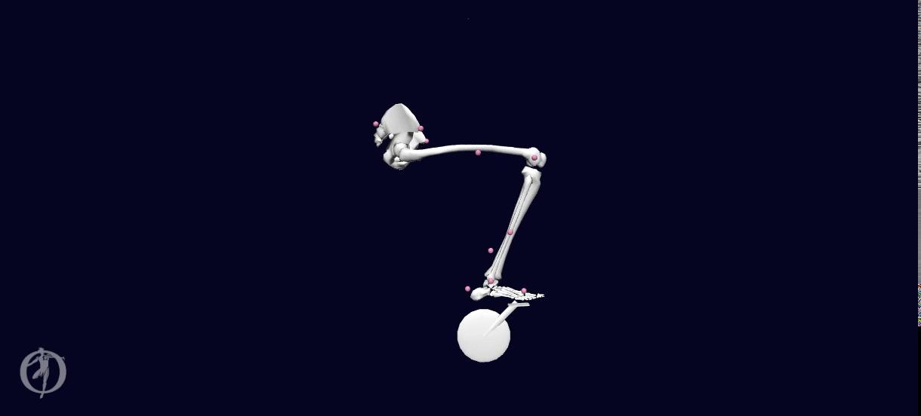
Updates: Constant Cadence
Using bare bones model
Notes:
Carmichael said we should just do with all muscles since we can drive cadence at constant speed

Slide 12
Updates: Muscles Added
Gastrocnemius added
Gastrocnemius & Tibialis Anterior added

Slide 13
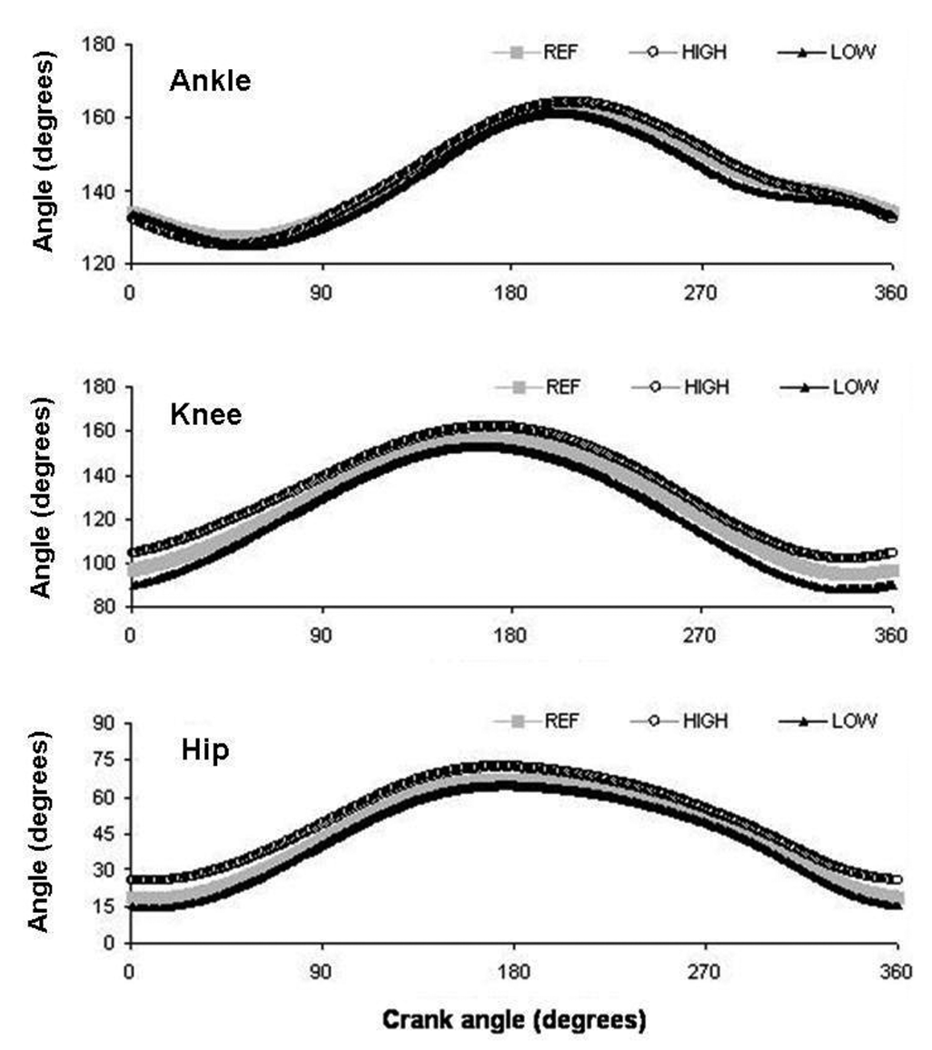
Cycling Kinematics
Many cycling experiments have been performed across the country to answer research questions surrounding cycling kinematics, dynamics, and power output [2] [7] [8] [9] [10] [11] [12] [16] [17] [18] [25] [26]
Studies often use electromyography (EMG) and motion capture data to acquire muscle activation and joint angle data
Experimental data is crucial in verifying the fidelity of musculoskeletal modeling
Joint angles for ankle, knee, hip as a function of crank angle [4]

Slide 14
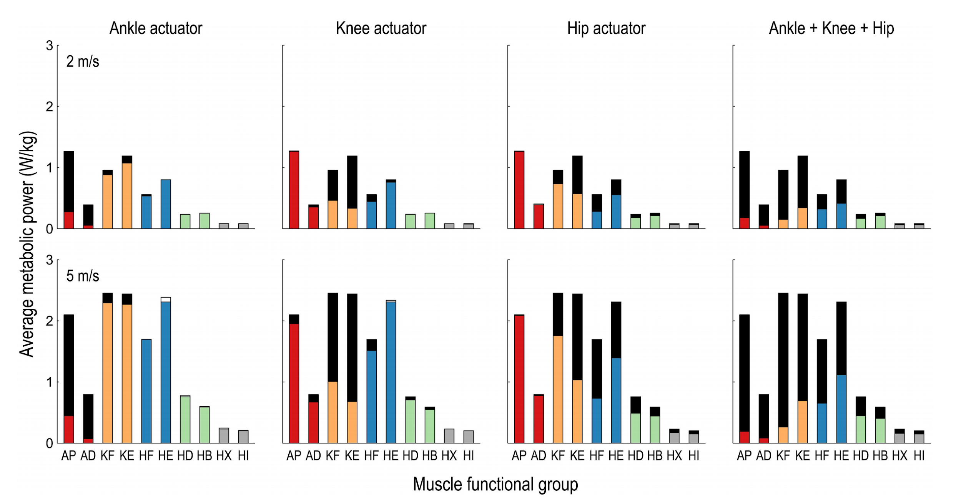
History of OpenSim and Metabolics
OpenSim was released as an open-source science tool by Dr. Scott Delp and team at Stanford in 2007
Used extensively in biomechanics research & industry
OpenSim has been used to study metabolic efficiency of walking and running ^{[13] [15] [15]}, making use of the Computed Muscle Control (CMC) tool
The CMC tool calculates synergistic muscle activations to produce a motion that best matches the imposed kinematics
Metabolic energy expenditure results are often validated with indirect calorimetry measurements ^{[13] [15] [15]}
Metabolic output from running as a function of leg muscles [3]

Slide 15
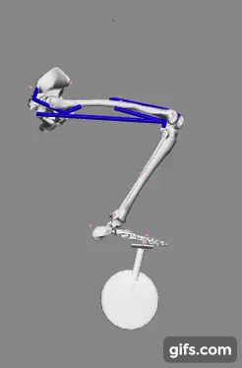
Past Stanford Project Cycling Model
Existing one-legged OpenSim cycling model from ME485: Modeling/Simulation of Human Movement ^{[19]}
Model contains limited complexity: only 4 muscles, pelvis location pinned, midfoot constrained at pedal, driven with only 1-2 muscle(s) activated at start of pedaling stroke
Starting point for our team
Two-muscle actuation showcasing simplified cycling kinematics [5]

Slide 16
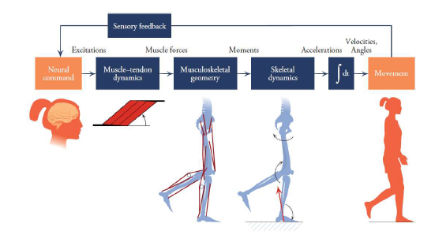
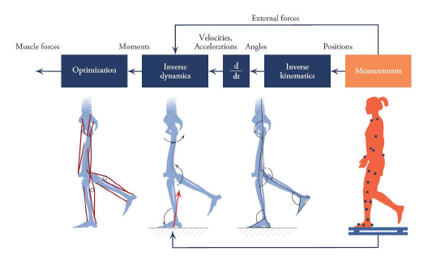
Forward Dynamics (L) vs. Inverse Dynamics (R)
Source: Figure 1.12 and Figure 1.13 Biomechanics of Movement: The Science of Sports, Robotics, and Rehabilitation by Thomas K. Uchida and Scott L. Delp (2020)

Slide 17
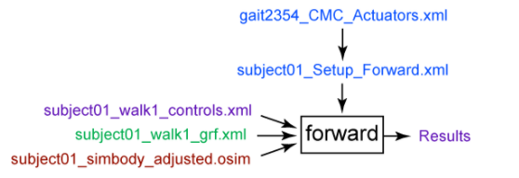
OpenSim Crash Course
Forward Dynamics
The Forward Dynamics Tool is used to calculate joint kinematics based on assumed muscle activations.
Simplest tool
Downside: Muscle activations assumed.
https://simtk-confluence.stanford.edu/display/OpenSim/Getting+Started+with+Forward+Dynamics
Inputs: Muscle excitation w.r.t. time, constraints on bodies’ coordinates (e.g. pelvis xyz-position, foot-on-pedal)
Outputs: Can obtain a wide array of outputs while muscle activation drives the simulation. Most useful will typically be joint angles, muscle-fiber lengths, and other body kinematics.
Notes:
The purpose of inverse kinematics (IK) is to estimate joint angles from experimental data. The purpose of inverse dynamics (ID) is to estimate forces & moments.
CMC is likely our primary tool for obtaining the relevant muscle forces with a well defined trajectory (joint angles) and external loads (pedal reaction forces)

Slide 18
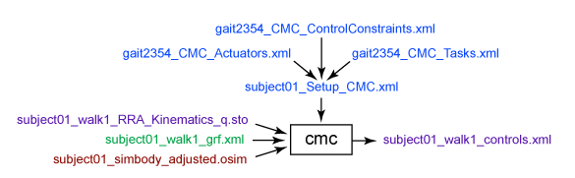
OpenSim Crash Course
CMC Tool (Computed Muscle Control)
The CMC tool is used to calculate muscle excitations based on desired kinematic inputs under various constraints/ boundary conditions.
Difficult to obtain convergence/ optimization
https://simtk-confluence.stanford.edu/display/OpenSim/Getting+Started+with+CMC
Inputs: Kinematics (joint angles, translations), coordinate tracking requests, constraints, actuation, GRFs
Outputs: Muscle activation forces, muscle activations/controls, muscle states of motion (joint angles & velocities; muscle fiber lengths & activations)
Ability to request Metabolic Probes
CMC Tool incorporate principles from Inverse Kinematics (IK) & Inverse Dynamics (ID) workflows
Notes:
The purpose of inverse kinematics (IK) is to estimate joint angles from experimental data. The purpose of inverse dynamics (ID) is to estimate forces & moments.
CMC is likely our primary tool for obtaining the relevant muscle forces with a well defined trajectory (joint angles) and external loads (pedal reaction forces)

Slide 19
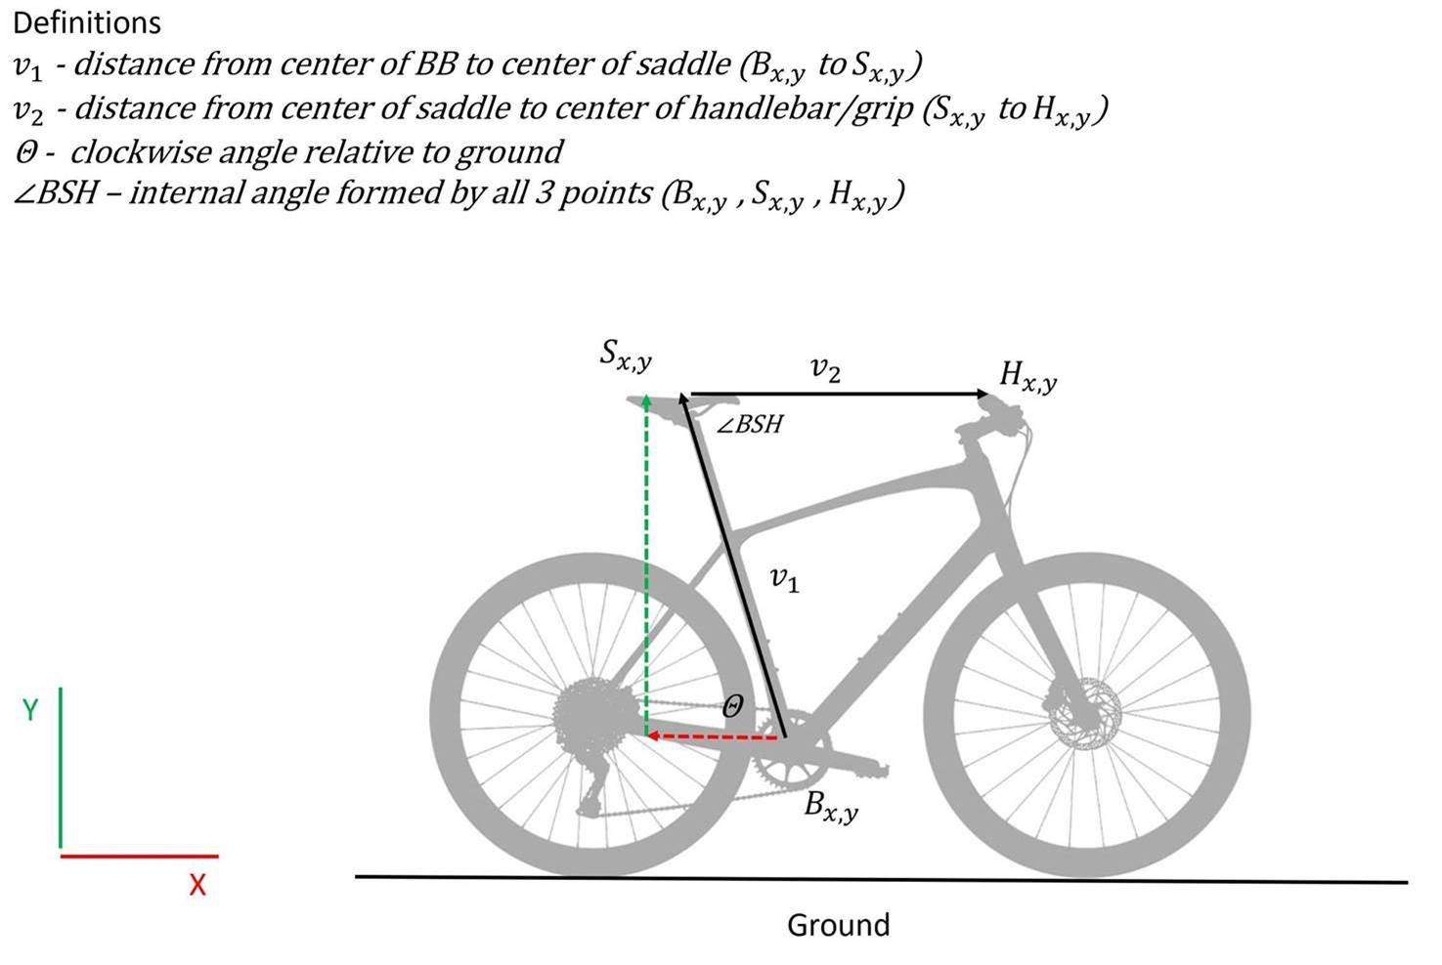
Adjust OpenSim Model Input
Saddle position, S_{x,y}
[18]
Notes:
Constraints
Muscles
Cadence
https://simtk-confluence.stanford.edu/display/OpenSim/OpenSim+Teaching+Materials+--+Educational+Cycling+Model
Included muscles are 1 quadriceps head (vastus intermedius), hamstrings (biceps femoris long and short heads), and gluteus maximus.
Constr
4 upper leg muscles, pelvis constrained to saddle, metatarsal constrained to pedal
1 muscle excitation forward dynamics External forces generated from forward dynamics constraints

Slide 20
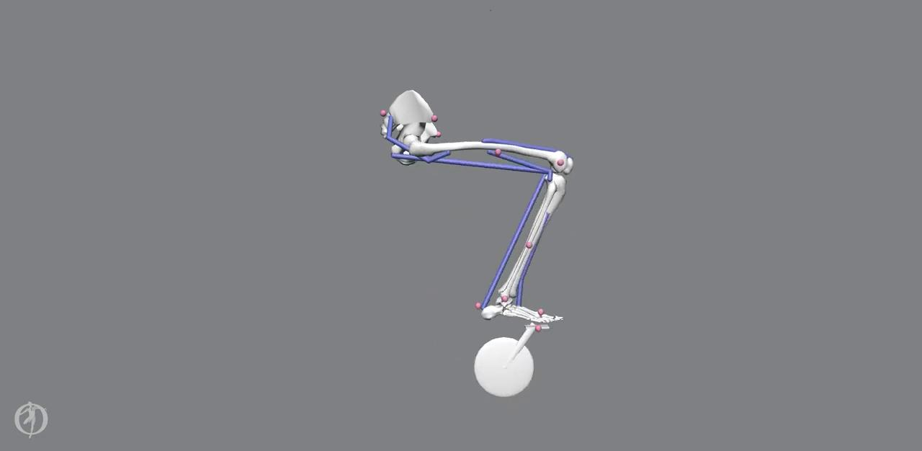
Simulate Passive Model for Kinematics
Notes:
Speed is 0.5x
This is what we will refer to as our “bare bones” cycling model. It is adapted from the original ME 485 model, however we strip off the musculature completely, leaving us with only rigid bodies and free of dissipative forces.
We then allow the pelvis to be locked in space, essentially fixed to the saddle position, and the foot constrained to the pedal. The crank angle is prescribed to a linearly increasing function in time, yielding a constant cadence.
This is the streamlined approach we will use to capture joint angle trajectories as we iterate through a wide range of saddle positions.

Slide 21
Adjust OpenSim CMC Tool Input Files
Setup File
Motion File (Kinematics)
Tracking Tasks File
Actuators & Controls
External Forces (GRFs)
[17]
Notes:
CEC Additional Constraints File (optional)
each of the files is specific and must be tailored to accommodate each model’s kinematics and anthropometric measurements
files must be specific for each model’s kinematics because the human body is highly variable
Muscle (length, velocity, activation)
High flexion/low flexion conditions
Realistic dynamics is optimization problem of different combo of muscles activations and timings
Multi scale model (muscles; bones; over large joint angles)
we have established a set of overall files --> expect and anticipate minor modifications needed in between kinematic sets
TT weights actuation constraints
Confirmed with opensim expert as best version of streamlined process

Slide 22
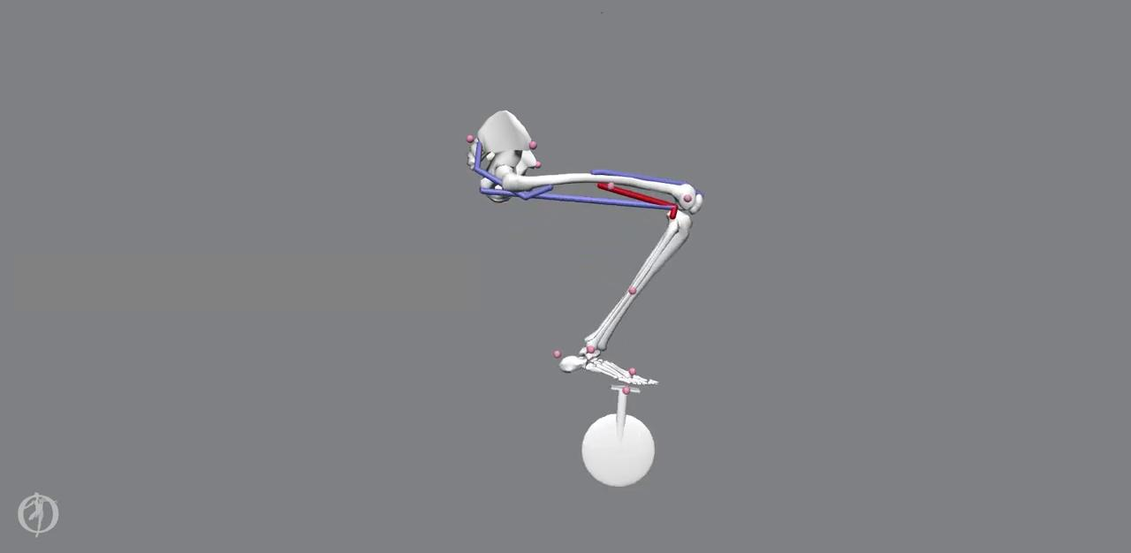
Run CMC Tool with Metabolic Probes
CMC Trial 8e
Notes:
CEC
Step 4: run CMC Tool and extract muscle excitations and metabolic probe data
See in the following slides what constitutes criteria for acceptable results
Next steps for testing:
Change saddle position (X,Y)
Discover how changes affect muscle activations & metabolic cost

